Slide 1

BOOKIT
BookIt
BOOKIT

Slide 2
BOOKIT
TABLE OF CONTENTS
·01·
·02·
·03·
·04·
BOOKIT
ABSTRACT
E-R DIAGRAM
STRUCTURE & CONTENT
SUB-QUERIES
·05·
·06·
JOINS
VIEWS

Slide 3

BOOKIT
·01·
ABSTRACT
BOOKIT

Slide 4
BOOKIT
ABSTRACT
BOOKIT
BookIt is a venue booking system, which is a comprehensive database project designed to manage and optimize the booking of venues such as auditoriums, seminar halls, and meeting rooms, etc.
This project involves creating a relational database with four primary tables: User, Admin, Venue, and Booking. The system facilitates efficient data storage and retrieval to support seamless interaction between users, admins, and venues.

Slide 5

·02·
E-R DIAGRAM
BOOKIT
BOOKIT

Slide 6
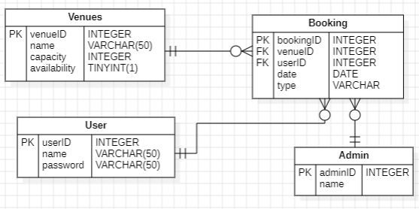
BOOKIT
E-R DIAGRAM
BOOKIT

Slide 7

·03·
STRUCTURE & CONTENT
BOOKIT
BOOKIT

Slide 8
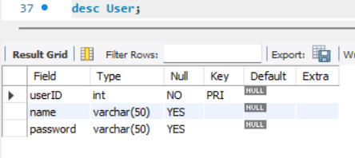
BOOKIT
STRUCTURE
BOOKIT
User Table
This table shows the user’s data containing userID, name, password.
Syntax: desc User;

Slide 9
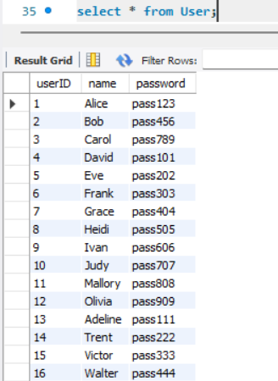
BOOKIT
CONTENTS OF USER TABLE
BOOKIT

Slide 10
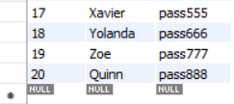
BOOKIT
CONTENTS OF USER TABLE
BOOKIT

Slide 11
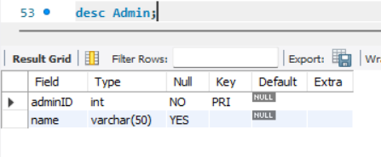
BOOKIT
STRUCTURE
BOOKIT
Admin Table
This table shows the admin’s data containing adminID, name.
Syntax: desc Admin;

Slide 12
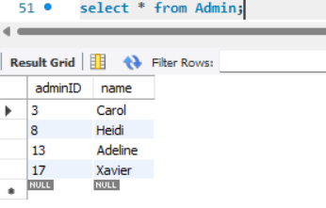
BOOKIT
CONTENTS OF ADMIN TABLE
BOOKIT

Slide 13
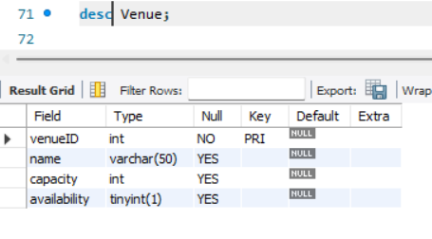
BOOKIT
STRUCTURE
BOOKIT
Venue Table
This table shows the venue’s data containing venueID, name, capacity, availability.
Syntax: desc Venue;

Slide 14
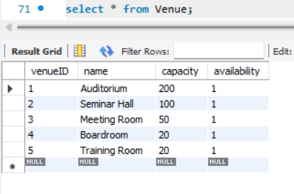
BOOKIT
CONTENTS OF VENUE TABLE
BOOKIT

Slide 15
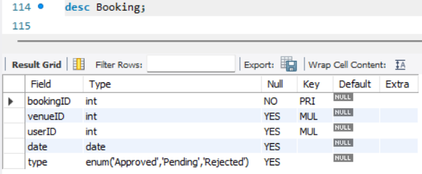
BOOKIT
STRUCTURE
BOOKIT
Booking Table
This table shows booking data of the venue containing bookingID, venueID, userID, date, type.
Syntax: desc Booking;

Slide 16
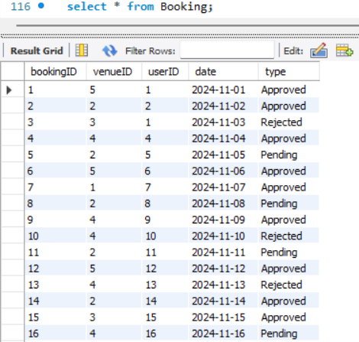
BOOKIT
CONTENTS OF BOOKING TABLE
BOOKIT

Slide 17
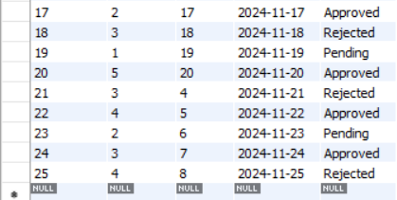
BOOKIT
CONTENTS OF BOOKING TABLE
BOOKIT

Slide 18

·04·
SUB-QUERIES
BOOKIT
BOOKIT

Slide 19
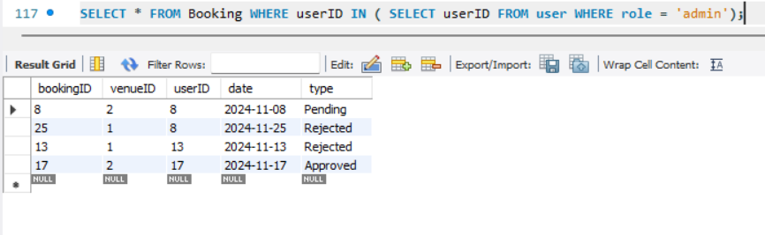
SUB-QUERY
BOOKIT
Find all bookings made by admin users:
SELECT * FROM Booking
WHERE userID IN ( SELECT userID
FROM user
WHERE role = 'admin');
BOOKIT

Slide 20
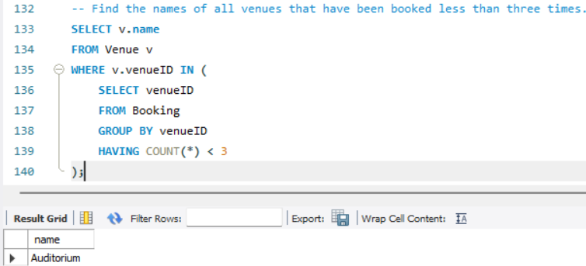
SUB-QUERY
BOOKIT
Find the names of all venues that have been booked less than three times :
SELECT v.name FROM Venue v
WHERE v.venueID IN (
SELECT venueID
FROM Booking
GROUP BY venueID
HAVING COUNT(*) < 3
);
BOOKIT

Slide 21
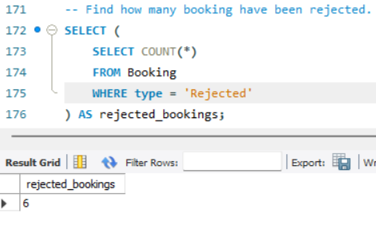
SUB-QUERY
BOOKIT
Find how many booking have been rejected:
SELECT ( SELECT COUNT(*)
FROM Booking
WHERE type = 'Rejected’)
AS rejected_bookings;
BOOKIT

Slide 22
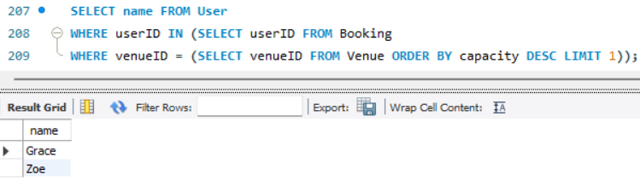
SUB-QUERY
BOOKIT
Find users who have made bookings in the venue with the largest capacity:
SELECT name FROM User
WHERE userID IN (SELECT userID
FROM Booking
WHERE venueID = (SELECT venueID FROM Venue
ORDER BY capacity DESC LIMIT 1));
BOOKIT

Slide 23

·05·
JOINS
BOOKIT
BOOKIT

Slide 24
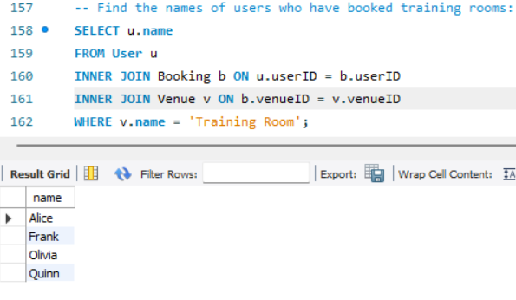
JOINS
BOOKIT
Find the names of users who have booked training rooms:
SELECT u.name FROM User u
INNER JOIN Booking b
ON u.userID = b.userID
INNER JOIN Venue v
ON b.venueID = v.venueID
WHERE v.name = 'Training Room';
BOOKIT

Slide 25
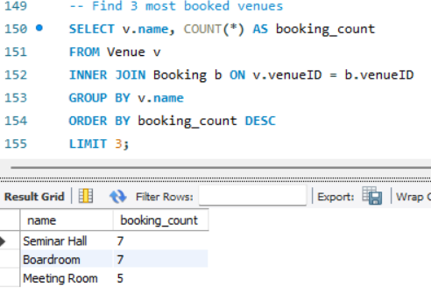
JOINS
BOOKIT
Find the top 3 most booked venues:
SELECT v.name, COUNT(*) AS booking_count
FROM Venue v
INNER JOIN Booking b ON v.venueID = b.venueID
GROUP BY v.name
ORDER BY booking_count DESC
LIMIT 3;
BOOKIT

Slide 26
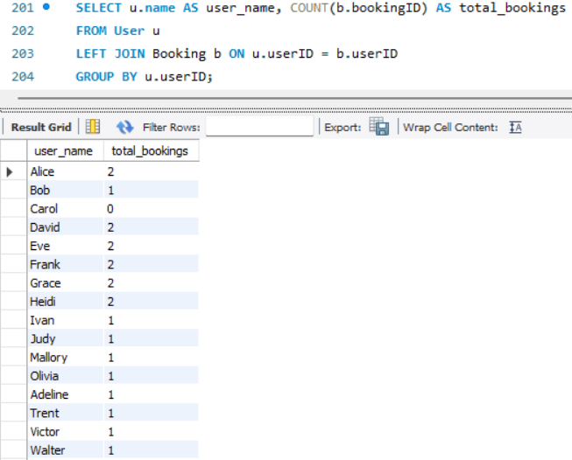
JOINS
BOOKIT
Find the number of bookings made by each user :
SELECT u.name AS user_name, COUNT(b.bookingID) AS total_bookings
FROM User u
LEFT JOIN Booking b ON u.userID = b.userID
GROUP BY u.userID;
BOOKIT

Slide 27
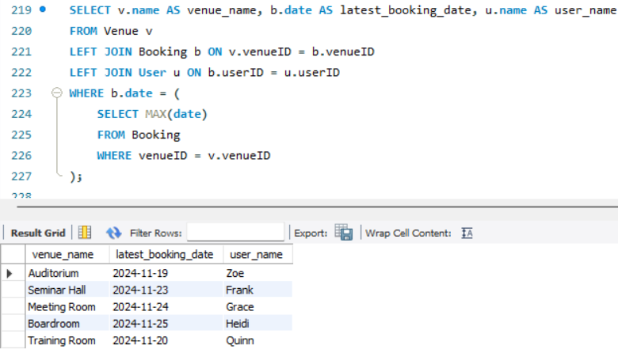
JOINS
BOOKIT
Find the latest booking of venue made by user :
SELECT v.name AS venue_name,
b.date AS latest_booking_date,
u.name AS user_name
FROM Venue v
LEFT JOIN Booking b
ON v.venueID = b.venueID
LEFT JOIN User u ON b.userID = u.userID
WHERE b.date = (SELECT MAX(date
FROM Booking
WHERE venueID = v.venueID);
BOOKIT

Slide 28

·05·
VIEWS
BOOKIT
BOOKIT

Slide 29
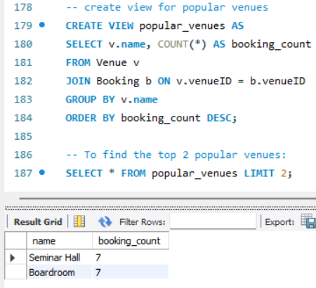
VIEWS
BOOKIT
Create view to find popular venues:
CREATE VIEW popular_venues AS
SELECT v.name, COUNT(*) AS booking_count
FROM Venue v
JOIN Booking b ON v.venueID = b.venueID
GROUP BY v.name
ORDER BY booking_count DESC;
BOOKIT

Slide 30
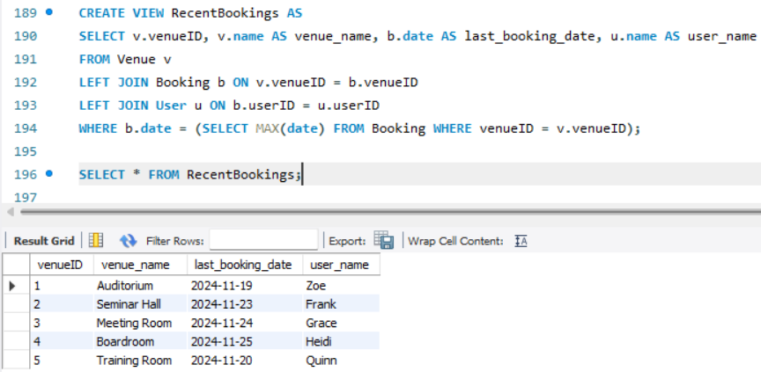
VIEWS
BOOKIT
Create view to find when was each venue last booked, and by whom:
CREATE VIEW RecentBookings AS
SELECT v.venueID, v.name AS venue_name, b.date AS last_booking_date, u.name AS user_name
FROM Venue v
LEFT JOIN Booking b
ON v.venueID = b.venueID
LEFT JOIN User u ON b.userID = u.userID
WHERE b.date = (SELECT MAX(date)
FROM Booking WHERE venueID = v.venueID);
SELECT * FROM RecentBookings;
BOOKIT

Slide 31
BOOKIT
THANK YOU
BOOKIT

